Slide 1


IEEE Signal Processing Society Seasonal School 28.03.2022 – 01.04.2022 Networked Federated Learning Theory, Algorithms and Applications Alex Jung (Aalto University)

Slide 2
About Me.
MSc (2008) and Ph.D. (2012) in EE, TU Vienna
since 2015 Ass. Prof. for Machine Learning at Aalto/CS
leading group “Machine Learning for Big Data”
2020- Associate Editor for IEEE Signal Processing Letters
2019-2022: Chair of IEEE Finland Jt. Chapter SP/CAS
Notes:
Let me give a quick overview of my academic journey so far. I have received a MSc and Phd in Electrical Engineering in 2008 and 2012, respectively, both from TU Vienna. Since 2015 I am an assistant professor at the Department of Computer Science at Aalto University. Here I am leading the group Machine Learning for Big Data which is researching and teaching the mathmatical foundations of machine learning.

Slide 3
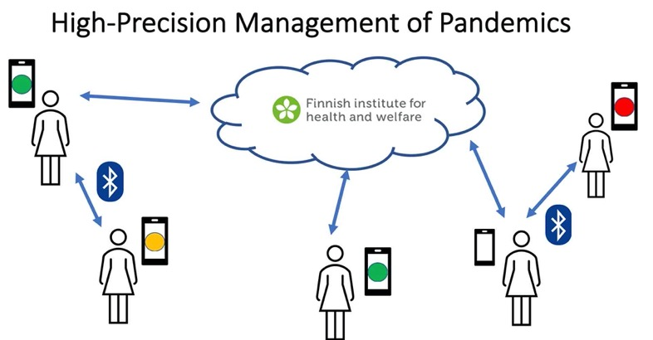
RA1: Networked Federated Learning.
Y. Sarcheshmehpour, M Leinonen and AJ, “Federated Learning From Big Data Over Networks”, IEEE ICASSP, 2021.
AJ, “Networked Exponential Families for Big Data Over Networks,” in IEEE Access, 2020, doi: 10.1109/ACCESS.2020.3033817.
AJ, N. Tran, “Localized Linear Regression in Networked Data,” in IEEE SPL, 2019, doi: 10.1109/LSP.2019.2918933.
Notes:
Our current research focus is two areas. The first research area is federated mutl-task learning which is relevant e.g. for the high-precision management of pandemics. Indeed, the personalized predicition of infection risks results in a networked collection of individual learning tasks. Each single task corresponds to learning accurated infection risk predictors for a particular person. I will talk more about how the statistical and computational aspects of such federated multit-task earning problems udring the main part of my talk.

Slide 4
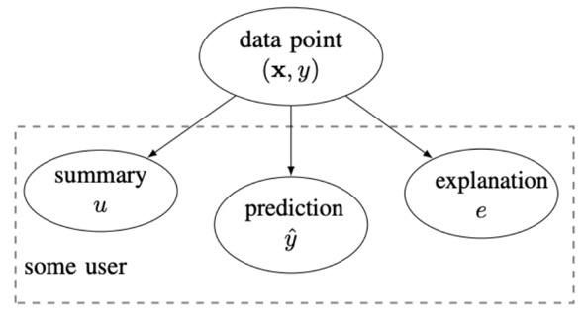
RA2: Explainable Machine Learning.
explanation can be:
relevant example of training set
subset of features
counterfactuals
a free text explanation
court sentence
AJ, “Explainable Empirical Risk Minimization”, arXiv eprint, 2020. weblink
AJ Jung and P. H. J. Nardelli, “An Information-Theoretic Approach to Personalized Explainable Machine Learning,” in IEEE SPL, 2020, doi: 10.1109/LSP.2020.2993176.
Notes:
Our second current research area is explainable machine learning. Our take on this hot topic is to measure the usefulness of an explanation by the amount by which the entropy of the prediction is reduced. An explanation can be any artefact that is revealed together with the prediction. For example, an explanation could amount to selecting a particular training example. Another form of explanations is obtained by listing a set of most relevant features. Formally, we model the explanation and prediction as correlated random variables. This information-theoretic approach is appealing as it allows to take into account the user background knowledge. We characterize the user background by a user summary that is provided by a training set. We use the user summary to design explanations that maximally reduce the uncertainty about a prediction for a specific user.

Slide 5



School Format.
Exercises
(independent work)
Lectures
(via zoom, recorded)
Discussion Forum
click here to join
Notes:
Let me give a quick overview of the organization of our seasonal school. We will have lectures via zoom which will be recorded and made available to participants. Don’t worry if you cannot attend them live. Another main component of the school are exercises.

Slide 6
all times EET/local Helsinki time)
hall: https://aalto.zoom.us/j/64034033878?pwd=ayt4aDNyaEVSSGt1eHNNZFVFR2RoZz09
Tue, 11:00-13:00, Basics of spectral graph theory, Prof. Avratchenkov
We, 10:00-11:00, Parallel/distributed methods for state-space models, Prof. Särkkä
We, 12:30-13:30, Compact and Efficient Neural Networks, Steps Towards Communication Efficient Federated Learning, Dr. H. Tavakoli
Thu., 11:00-12:00, Machine Learning applications in meteorological forecasting, Dr. Schicker
Thu, 13:00-14:00, Towards Communication-Efficient and Personalized Federated Learning, Dr. Samek
Thu, 14:30-15:30, Communication-Computation Efficient Distributed Machine Learning , Prof. Fischione
Fr, 11:00-12:00, Tackling the problem of “bad” explanations with the Human-in-the-Loop principle, Dipl.-Ing. Saranti
Notes:
Let me give a quick overview of the organization of our seasonal school. We will have lectures via zoom which will be recorded and made available to participants. Don’t worry if you cannot attend them live. Another main component of the school are exercises.

Slide 7

Discussion Forum („Slack“)
can be used via web-browser or with
an installed app;
link to join is on school site
https://ieeespcasfinland.github.io/
post your questions there in suitable
channel, e.g., “exercise1”
don’t hesitate to answer other’s questions
Notes:
Let me give a quick overview of the organization of our seasonal school. We will have lectures via zoom which will be recorded and made available to participants. Don’t worry if you cannot attend them live. Another main component of the school are exercises.

Slide 8


School Assistants.
Dr. Yu Tian
Dr. Shamsiiat (Shamsi) Abdurakhmanova
Notes:
Let me give a quick overview of the organization of our seasonal school. We will have lectures via zoom which will be recorded and made available to participants. Don’t worry if you cannot attend them live. Another main component of the school are exercises.

Slide 9
Exercises.
three exercises: Exercise 1, 2 and 3
each exercise consists of a Python notebook
notebook contains starter code and explanations
tasks at the end of notebooks
Notes:
Let me give a quick overview of the organization of our seasonal school. We will have lectures via zoom which will be recorded and made available to participants. Don’t worry if you cannot attend them live. Another main component of the school are exercises.

Slide 10
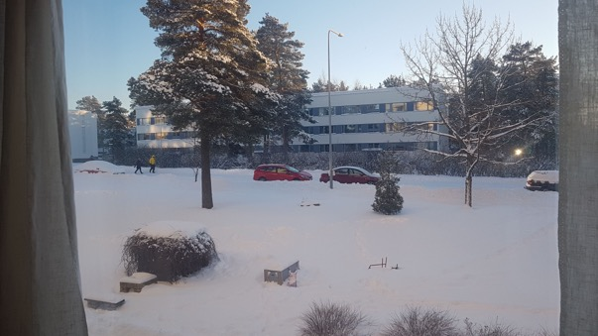



Running Toy Application
morning temperature = - 10 (minimum daytime temp.)
maximum daytime temperature ?
Notes:
We consider data as collections or lists of datapoints. A datapoint is any object that potentially carries relevant information for some ML task. Here, a data point represents a daily weather condition at some location in Finland. You can see some Python code that reads in datapoints form a csv file with the name FMIData.csv which has been downloaded from the Finnish Meterological institute. We then print out the first five datapoints from this file. Each data point is characterized by several properties. In machine learning we call properties that we can measure easily as features. Properties that represent a quantity of interest are referred to as labels. The label is only known for some carefully selected datapoints. In general we want to predict the label based on the feature.

Slide 11


Exercise 1.
basic components of ML: data, model and loss
principle of empirical risk minimization (ERM)
solve ERM using gradient descent
read in datapoints from a csv file
Notes:
Let me give a quick overview of the organization of our seasonal school. We will have lectures via zoom which will be recorded and made available to participants. Don’t worry if you cannot attend them live. Another main component of the school are exercises.

Slide 12
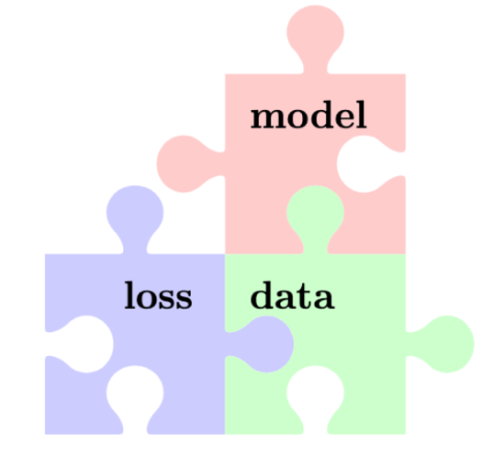
Three Components of ML
linear space
decision tree
neural nets
….
squared error
logistic loss
focal loss
….
numeric arrays
text
networks
…

Slide 13
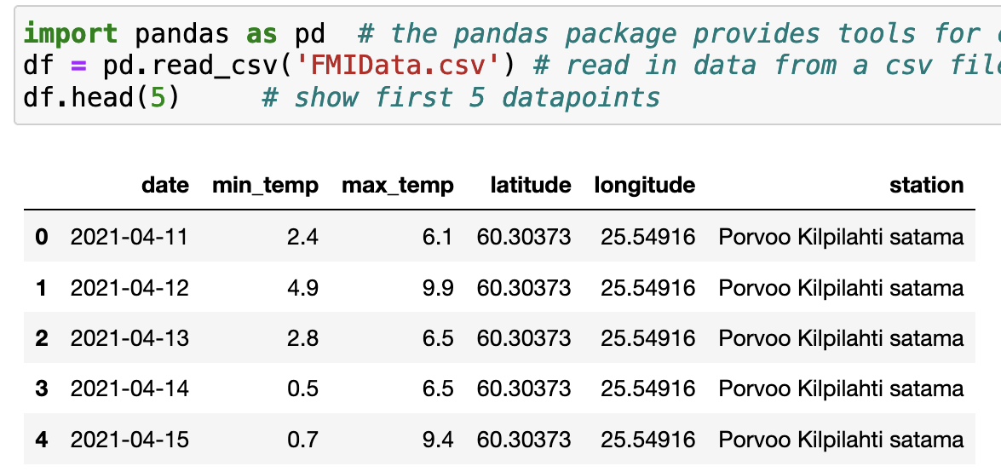
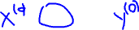
Data.
Notes:
We consider data as collections or lists of datapoints. A datapoint is any object that potentially carries relevant information for some ML task. Here, a data point represents a daily weather condition at some location in Finland. You can see some Python code that reads in datapoints form a csv file with the name FMIData.csv which has been downloaded from the Finnish Meterological institute. We then print out the first five datapoints from this file. Each data point is characterized by several properties. In machine learning we call properties that we can measure easily as features. Properties that represent a quantity of interest are referred to as labels. The label is only known for some carefully selected datapoints. In general we want to predict the label based on the feature.

Slide 14
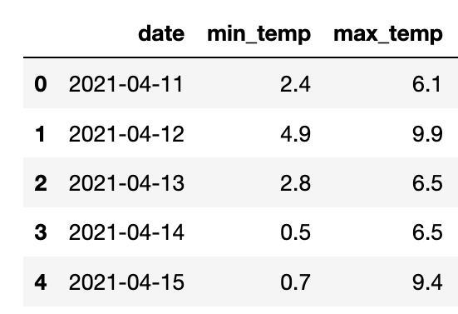
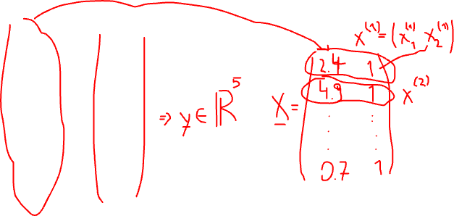
Feature Matrix and Label Vector.
Notes:
We consider data as collections or lists of datapoints. A datapoint is any object that potentially carries relevant information for some ML task. Here, a data point represents a daily weather condition at some location in Finland. You can see some Python code that reads in datapoints form a csv file with the name FMIData.csv which has been downloaded from the Finnish Meterological institute. We then print out the first five datapoints from this file. Each data point is characterized by several properties. In machine learning we call properties that we can measure easily as features. Properties that represent a quantity of interest are referred to as labels. The label is only known for some carefully selected datapoints. In general we want to predict the label based on the feature.

Slide 15
Linear Model
h’(x)=w1’*x1+w2’
label y (max.tmp.)
h(x)=w1*x1+w2
feature x1 (min.tmp.)

Slide 16
which hypothesis h(x), or model parameter w, is best?

Slide 17
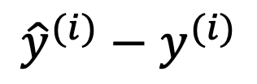
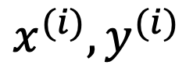
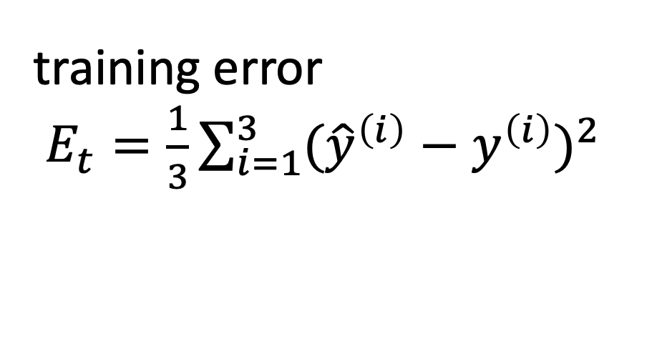
Mean Squared Error
$${\hat{y}}^{(i)}−y^{(i)}$$
$$x^{(i)},y^{(i)}$$
label y
training error
$E_{t}=\frac{1}{3}\sum_{i=1}^{3}{({\hat{y}}^{\left(i\right)}−y^{\left(i\right)})^{2}}$
feature x

Slide 18
Empirical Risk Minimization (informal)
learn hypothesis (model parameters) such that
the resulting average loss (“empirical risk”)
on a training set is minimal

Slide 19
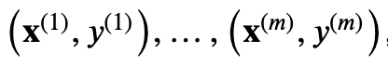
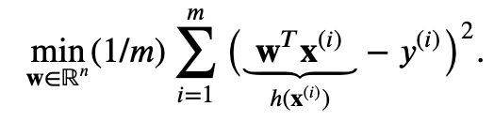
Empirical Risk Minimization
datapoints

Slide 20
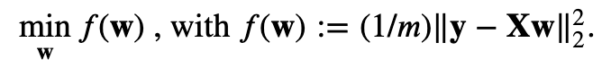
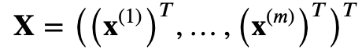
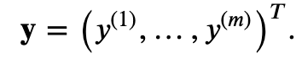
Matrix/Vector Notation
feature matrix
label vector

Slide 21
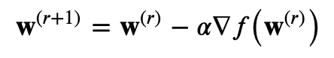
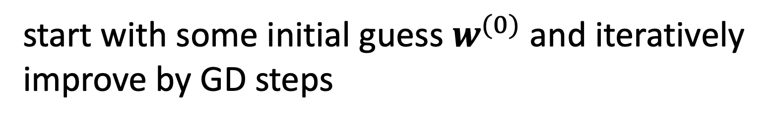
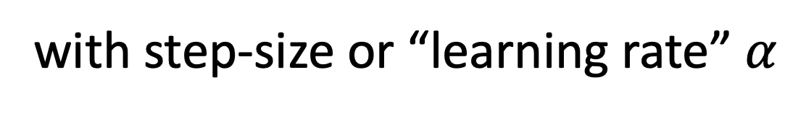
Gradient Descent
start with some initial guess $w^{(0)}$ and iteratively
improve by GD steps
with step-size or “learning rate” $α$

Slide 22
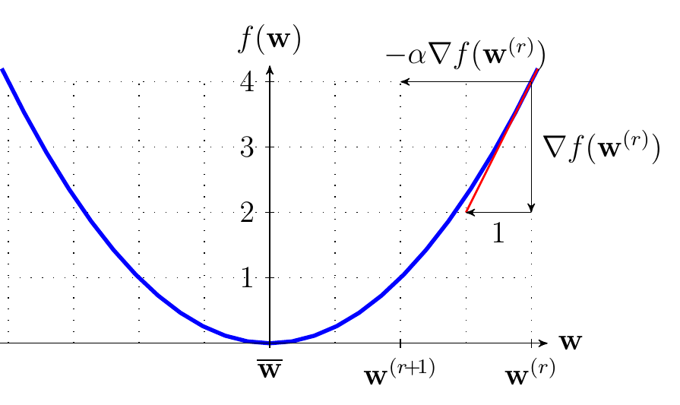
Gradient Descent Step

Slide 23
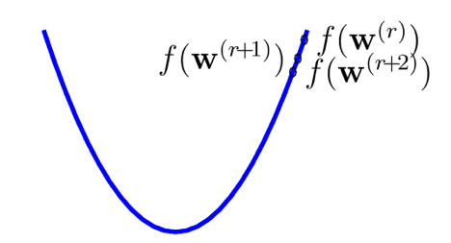
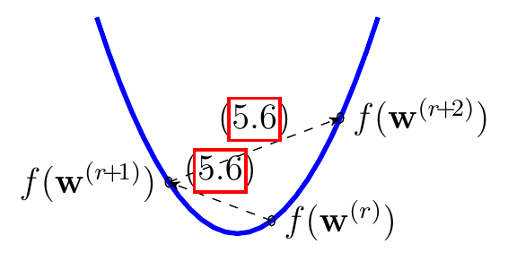
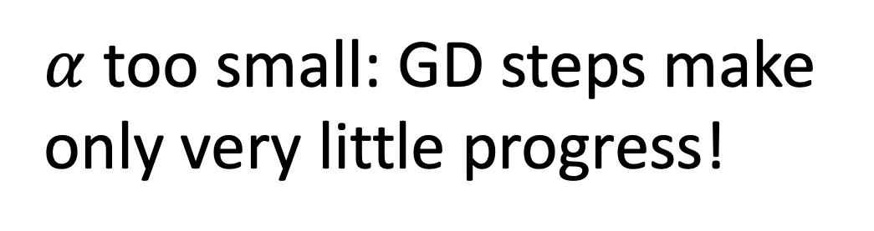
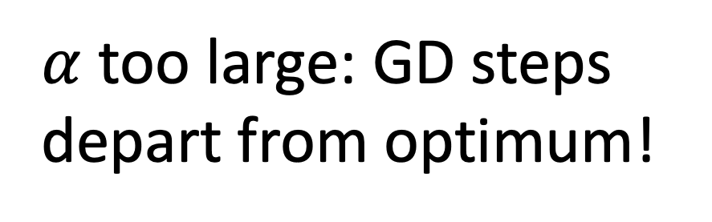
Effect of Learning-Rate.
$α$too small: GD steps make
only very little progress!
$α$too large: GD steps
depart from optimum!

Slide 24
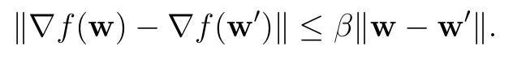
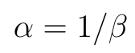
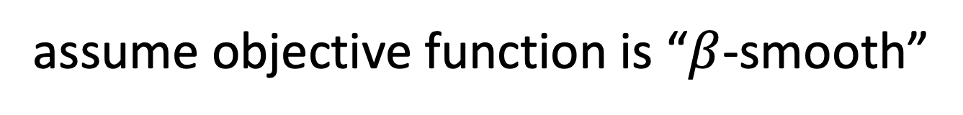
A Sufficient Condition.
assume objective function is “$β$-smooth”
GD converges when using learning rate
proof: https://www.stat.cmu.edu/~ryantibs/convexopt-F13/scribes/lec6.pdf

Slide 25
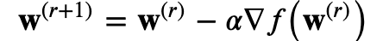
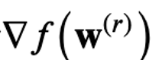
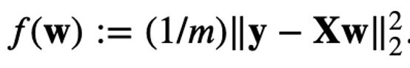
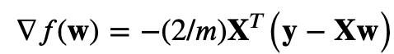
Computing Gradient.
to implement GD step
we need to compute gradient
for
we obtain
see A.4 of S. Boyd and L. Vandenberghe, "Convex Optimization", CUP, 2004

Slide 26
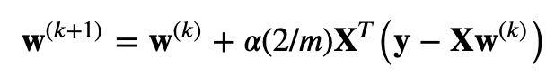
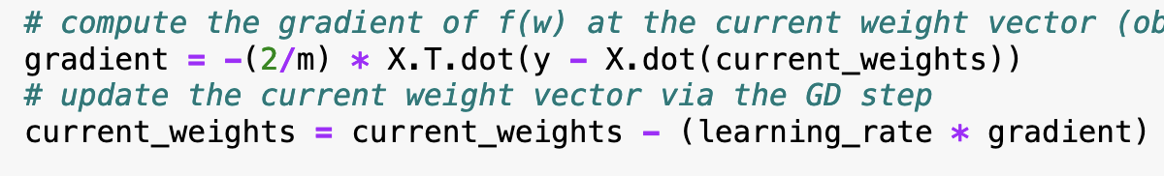
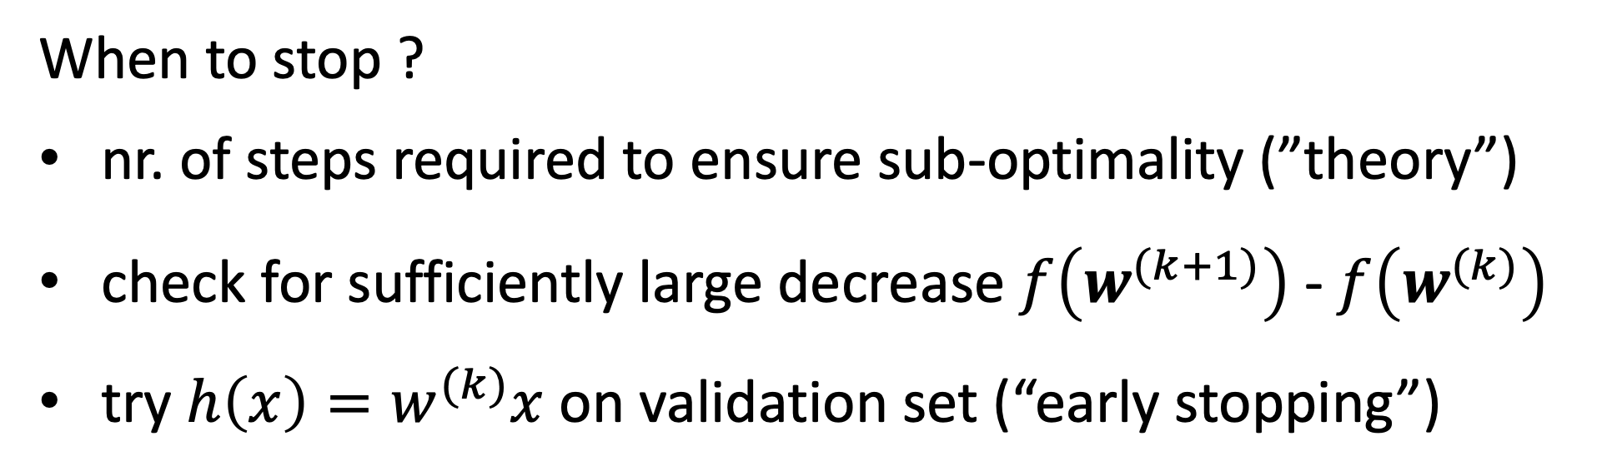
GD for Linear Regression.
When to stop ?
nr. of steps required to ensure sub-optimality (”theory”)
check for sufficiently large decrease $f\left(w^{(k+1)}\right)$ - $f\left(w^{(k)}\right)$
try $h\left(x\right)=w^{(k)}x$ on validation set (“early stopping”)

Slide 27
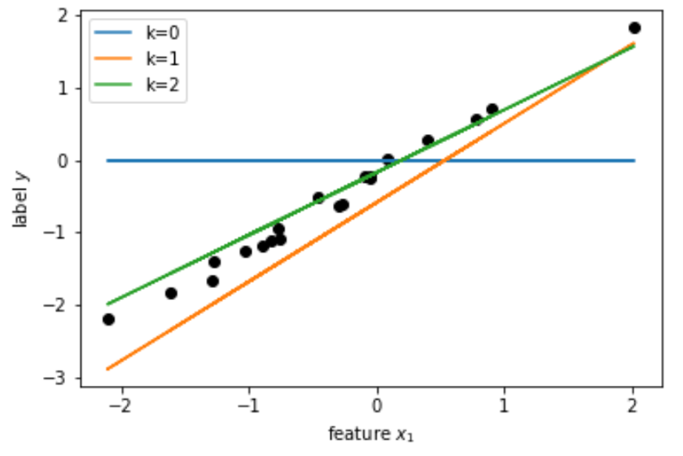
GD in Action.

Slide 28
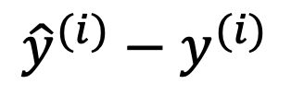
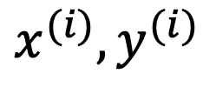
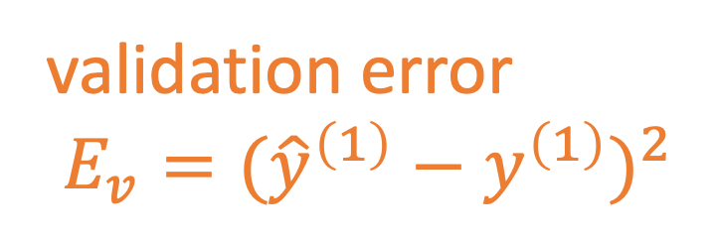
Train and Validate.
$${\hat{y}}^{(i)}−y^{(i)}$$
$$x^{(i)},y^{(i)}$$
label y
validation error
$E_{v}=({\hat{y}}^{\left(1\right)}−y^{\left(1\right)})^{2}$
feature x

Slide 29
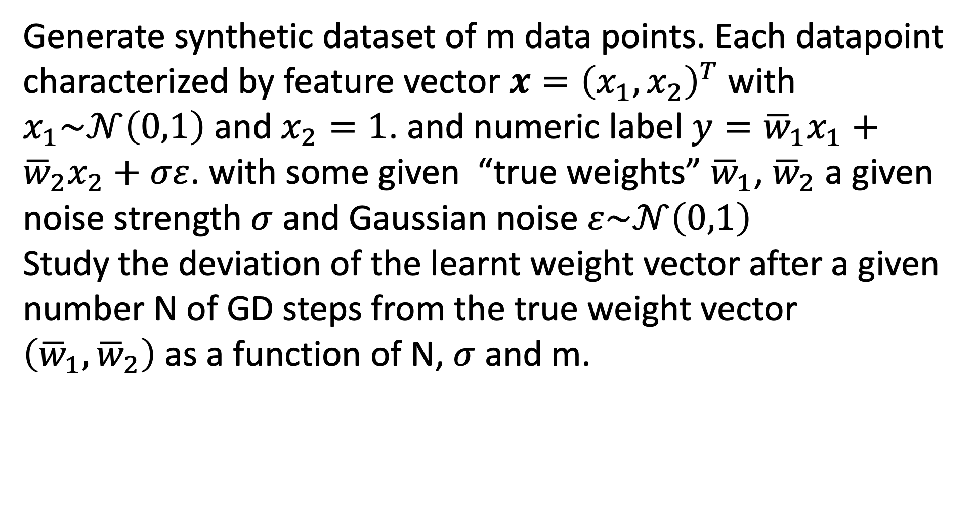
Exercise 1 – Task 1.1
Generate synthetic dataset of m data points. Each datapoint
characterized by feature vector $x={\left(x_{1},x_{2}\right)}^{T}$ with $x_{1}\sim 𝒩\left(0,1\right)$ and $x_{2}=1$. and numeric label $y={\overline{w}}_{1}x_{1}+{\overline{w}}_{2}x_{2}+σε$. with some given “true weights” ${\overline{w}}_{1}$, ${\overline{w}}_{2}$ a given noise strength $σ$ and Gaussian noise $ε\sim 𝒩\left(0,1\right)$
Study the deviation of the learnt weight vector after a given
number N of GD steps from the true weight vector $\left({\overline{w}}_{1},{\overline{w}}_{2}\right)$as a function of N, $σ$ and m.

Slide 30
Exercise 1 – Task 1.2
Learn the weights of a linear predictor for the maximum
daytime temperature (label) from the minimum daytime
temperature (feature) at some place in Finland. To achieve
this goal, use the datapoints in
https://raw.githubusercontent.com/ieeespcasfinland/ieeespcasfinland.github.io/main/FMIData.csv

Slide 31

Exercise 2
store networked data and models using networkx.Graph object
add local datasets and model parameters as node attributes
combine GD with a network averaging algorithm to collaboratively linear hypothesis from a network of local datasets

Slide 32
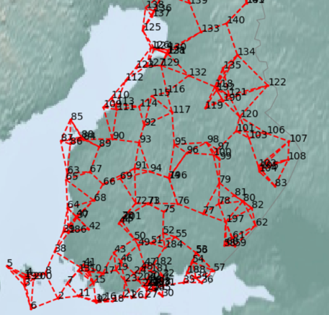
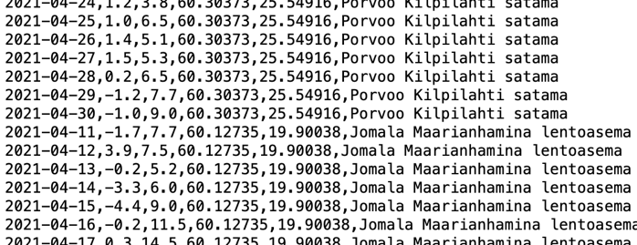
Network of Weather Data

Slide 33
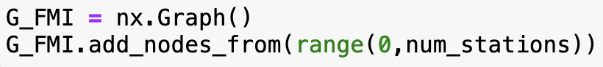
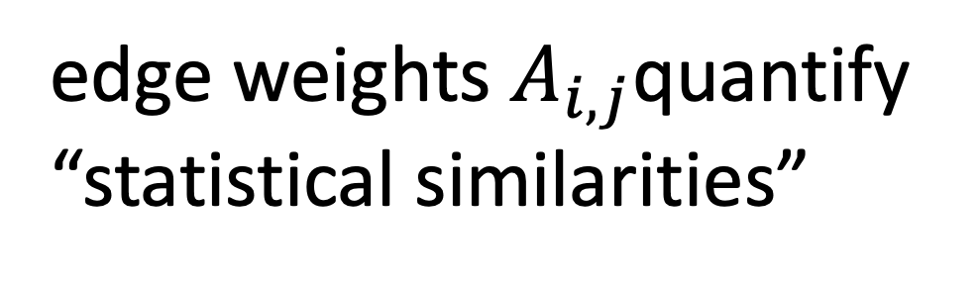
The Empirical Graph.
weather station i
“similar"
j
edge weights $A_{i,j}$quantify
“statistical similarities”
Notes:
We represent networked data using an undirected weighted graph which we refer to as the empirical graph. The nodes of the empirical graph represent individual local datasets, e.g., generated by a particular person or by a particular IoT sensing device. Two nodes are connected by an edge if they are similar in a domain-specific sense. This similarity notion might be be obtained from spatio-temporal proximity as in contact networks for disease spread or by presence/absence of direct communication links. Our research studies how to combine the geometry of the network or network topoloy with the geometry of local models that are used for each local dataset.

Slide 34
Attaching Local Datasets to Nodes
weather station i
Notes:
We represent networked data using an undirected weighted graph which we refer to as the empirical graph. The nodes of the empirical graph represent individual local datasets, e.g., generated by a particular person or by a particular IoT sensing device. Two nodes are connected by an edge if they are similar in a domain-specific sense. This similarity notion might be be obtained from spatio-temporal proximity as in contact networks for disease spread or by presence/absence of direct communication links. Our research studies how to combine the geometry of the network or network topoloy with the geometry of local models that are used for each local dataset.

Slide 35
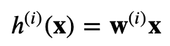
Attaching Linear Model to Nodes
weather station i
Notes:
We represent networked data using an undirected weighted graph which we refer to as the empirical graph. The nodes of the empirical graph represent individual local datasets, e.g., generated by a particular person or by a particular IoT sensing device. Two nodes are connected by an edge if they are similar in a domain-specific sense. This similarity notion might be be obtained from spatio-temporal proximity as in contact networks for disease spread or by presence/absence of direct communication links. Our research studies how to combine the geometry of the network or network topoloy with the geometry of local models that are used for each local dataset.

Slide 36
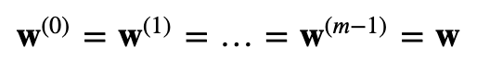
Learning a Global Model
learn global weight vector w via GD applied to linear regression for a single dataset obtained from pooling all local datasets
Notes:
We represent networked data using an undirected weighted graph which we refer to as the empirical graph. The nodes of the empirical graph represent individual local datasets, e.g., generated by a particular person or by a particular IoT sensing device. Two nodes are connected by an edge if they are similar in a domain-specific sense. This similarity notion might be be obtained from spatio-temporal proximity as in contact networks for disease spread or by presence/absence of direct communication links. Our research studies how to combine the geometry of the network or network topoloy with the geometry of local models that are used for each local dataset.

Slide 37
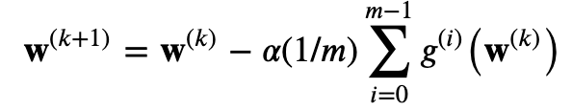
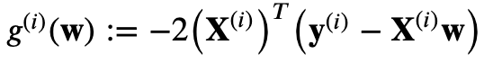
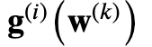
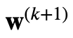

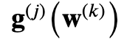
Centralized Federated Learning
GD step for linear regression on pooled local datasets:
local gradient
i
i
j
j
Notes:
We represent networked data using an undirected weighted graph which we refer to as the empirical graph. The nodes of the empirical graph represent individual local datasets, e.g., generated by a particular person or by a particular IoT sensing device. Two nodes are connected by an edge if they are similar in a domain-specific sense. This similarity notion might be be obtained from spatio-temporal proximity as in contact networks for disease spread or by presence/absence of direct communication links. Our research studies how to combine the geometry of the network or network topoloy with the geometry of local models that are used for each local dataset.

Slide 38

Distributed Federated Learning
GD step for linear regression on pooled local datasets:
local gradient
use network averaging to (approximately) compute
Notes:
We represent networked data using an undirected weighted graph which we refer to as the empirical graph. The nodes of the empirical graph represent individual local datasets, e.g., generated by a particular person or by a particular IoT sensing device. Two nodes are connected by an edge if they are similar in a domain-specific sense. This similarity notion might be be obtained from spatio-temporal proximity as in contact networks for disease spread or by presence/absence of direct communication links. Our research studies how to combine the geometry of the network or network topoloy with the geometry of local models that are used for each local dataset.

Slide 39


Network Averaging
j
k
i
for suitable choice of weights $W_{i,j}$ ,
Notes:
We represent networked data using an undirected weighted graph which we refer to as the empirical graph. The nodes of the empirical graph represent individual local datasets, e.g., generated by a particular person or by a particular IoT sensing device. Two nodes are connected by an edge if they are similar in a domain-specific sense. This similarity notion might be be obtained from spatio-temporal proximity as in contact networks for disease spread or by presence/absence of direct communication links. Our research studies how to combine the geometry of the network or network topoloy with the geometry of local models that are used for each local dataset.

Slide 40
Algorithm 1
init weights to zero at all nodes
2. repeat for N_GD times:
2.1 compute local gradients at all nodes
2.2 N_AV iterations of network averaging
2.3 do a GD step at each node
Notes:
We represent networked data using an undirected weighted graph which we refer to as the empirical graph. The nodes of the empirical graph represent individual local datasets, e.g., generated by a particular person or by a particular IoT sensing device. Two nodes are connected by an edge if they are similar in a domain-specific sense. This similarity notion might be be obtained from spatio-temporal proximity as in contact networks for disease spread or by presence/absence of direct communication links. Our research studies how to combine the geometry of the network or network topoloy with the geometry of local models that are used for each local dataset.

Slide 41
Exercise 2 – Task 2.1
Try out Algorithm 1 for a toy networked dataset
consisting of two clusters/blocks
study effect of having an edge between clusters,
varying number of GD steps, varying number of
network averaging iterations

Slide 42
Exercise 2 – Task 2.2
Try out Algorithm 1 for a networked data obtained
from Finnish meteorological institute (Demo code
shows to load this data)

Slide 43
Networked Federated Learning In a nutshell: organize data, models and computation for machine learning as networks.

Slide 44
Networked Federated Learning
Federated Learning
Machine Learning

Slide 45



Networked Federated Learning

Slide 46

Networked Data
Notes:
one enabler for training personalized models is networked data.

Slide 47


Weather Stations.

Slide 48
ImageNet.
“…ImageNet is an image database organized according to the WordNet hierarchy (currently only the nouns), in which each node of the hierarchy is depicted by hundreds and thousands of images…”
https://image-net.org/
Notes:
When we look at Image databases like ImageNet we can use object taxonomies or hierarchies to construct a network structure.

Slide 49
WordNet.
“…Nouns, verbs, adjectives and adverbs are grouped into sets of cognitive synonyms (synsets), each expressing a distinct concept… The resulting network of meaningfully related words and concepts can be navigated…..”
https://wordnet.princeton.edu/
Notes:
When we look at Image databases like ImageNet we can use object taxonomies or hierarchies to construct a network structure.

Slide 50

Wikidata.
https://www.wikidata.org/wiki/Wikidata:Main_Page
Notes:
Another important example for networked data is Wikidata. You can think of wikidata as a huge network with nodes representing data items that are related in many different ways. These relations are encoded in the links of the wikidata network.

Slide 51

Diseases.
Liu, Jiaqi & Ma, James & Wang, Jiaojiao & Zeng,
Daniel Dajun & Song, Hongbin & Wang, Ligui & Cao, Zhidong. (2016).
Comorbidity Analysis According to Sex and Age in Hypertension Patients in China.
International Journal of Medical Sciences. 13. 99-107. 10.7150/ijms.13456.
Notes:
Yet another application domain generating networked data Is medicine. Co-morbidity networks represent diseases as nodes of an empirical graph. These nodes are connected if the
represent diseases that occur together for many patients.

Slide 52

WSN.
Notes:
Yet another application domain generating networked data Is medicine. Co-morbidity networks represent diseases as nodes of an empirical graph. These nodes are connected if the
represent diseases that occur together for many patients.

Slide 53

Anchors.
Notes:
Yet another application domain generating networked data Is medicine. Co-morbidity networks represent diseases as nodes of an empirical graph. These nodes are connected if the
represent diseases that occur together for many patients.

Slide 54

The Empirical Graph in Python
local dataset
“similar"
edge weights $A_{i,j}$quantify
“statistical similarities”
Notes:
We represent networked data using an undirected weighted graph which we refer to as the empirical graph. The nodes of the empirical graph represent individual local datasets, e.g., generated by a particular person or by a particular IoT sensing device. Two nodes are connected by an edge if they are similar in a domain-specific sense. This similarity notion might be be obtained from spatio-temporal proximity as in contact networks for disease spread or by presence/absence of direct communication links. Our research studies how to combine the geometry of the network or network topoloy with the geometry of local models that are used for each local dataset.

Slide 55

Networked Models

Slide 56
Networked Models.
local model for each node
couple models at connected nodes
“similar"
Notes:
Starting with a given empirical graph we define a networked model. Each node is equipped with some parametric model with paramters of weights w. These local models could be linear regression models or deep neural nets. Our methods allow to abstract from the details of the local models and only need a loss function that provides a score for a given choice of weights.

Slide 57
Networked Parametric Models.
model params
“similar"
Notes:
Starting with a given empirical graph we define a networked model. Each node is equipped with some parametric model with paramters of weights w. These local models could be linear regression models or deep neural nets. Our methods allow to abstract from the details of the local models and only need a loss function that provides a score for a given choice of weights.

Slide 58
Generalized Total Variation (GTV)
force params of well connected
nodes to be similar by requiring
a small GTV
1
2

Slide 59
Two Special Cases of GTV.
total variation
graph Laplacian quadratic from is GTV with

Slide 60




Smooth Graph Signals.
$$x^{(i)}=w^{(i)}+n^{(i)}$$
$$A_{i,j}$$
$$x^{(j)}=w^{(j)}+n^{(j)}$$
low pass constraint on
$$\sum_{\left\{i,j\right\}}{A_{i,j}{\left(w^{(i)}−w^{(j)}\right)}^{2}}$$
Notes:
Starting with a given empirical graph we define a networked model. Each node is equipped with some parametric model with paramters of weights w. These local models could be linear regression models or deep neural nets. Our methods allow to abstract from the details of the local models and only need a loss function that provides a score for a given choice of weights.

Slide 61

GTV Minimization.

Slide 62

Local Loss Functions.
model params
measure quality of params by local loss function
$$L^{(i)}\left(w^{(i)}\right)$$
Notes:
The local loss function encapsulates the local dataset from the perspective of federated learning algorithms. We only need the local dataset to construct a local loss function to score different choices for the parameters.

Slide 63

GTV Minimization.
$$\min_{w}{\sum_{iεΜ}{L^{(i)}\left(w^{(i)}\right)}+λ\sum_{\left\{i,j\right\}}{A_{i,j}φ\left(w^{(i)}−w^{(j)}\right)}}$$
increasing
average local loss
“clusteredness”
training set

Slide 64


Special Case: Network Lasso.
$$\min_{w}{\sum_{iεΜ}{L^{(i)}\left(w^{(i)}\right)}+λ\sum_{\left\{i,j\right\}}{A_{i,j}\left\|w^{(i)}−w^{(j)}\right\|}}$$

Slide 65


Special Case: “MOCHA”
$$\min_{w}{\sum_{iεΜ}{L^{(i)}\left(w^{(i)}\right)}+λ}\sum_{\left\{i,j\right\}}{A_{i,j}{\left\|w^{(i)}−w^{(j)}\right\|}^{2}}$$

Slide 66

Special Case: Graph Sig. Recovery
$$\min_{w}{\sum_{iεΜ}{{\left(x^{(i)}−w^{(i)}\right)}^{2}}+λ}\sum_{\left\{i,j\right\}}{A_{i,j}{\left(w^{(i)}−w^{(j)}\right)}^{2}}$$

Slide 67


GTVMin is Multi-Task Learning
learn model params jointly for all nodes exploit similarities between local datasets
Notes:
We then aim at learning separate weights for each local dataset. This is a multi-task learning problem with each local data being a separate learning task. To have any chance at solving this multi-task learning problem we exploit similarities' between the individual tasks that is tied to the network structure.

Slide 68



GTVMin is Locally Weighted Learning
$$𝒳^{(j)}$$
pool local datasets of nodes
in the same cluster
$$𝒳^{(i)}$$
$$𝒳^{(k)}$$
William S. Cleveland, Susan J. Devlin, Eric Grosse,
“Regression by local fitting: Methods, properties, and computational algorithms,”
Journal of Econometrics, Volume 37, Issue 1, 1988.

Slide 69
Computational and Statistical Aspects.
how to solve GTVMin efficiently?
are GTVMin solutions statistically useful?

Slide 70

Computational Aspects.
$$\min_{w}{\sum_{iεΜ}{L^{(i)}\left(w^{(i)}\right)}+λ\sum_{\left\{i,j\right\}}{A_{i,j}φ\left(w^{(i)}−w^{(j)}\right)}}$$
in-network computation using low-cost devices
robustness against node/link failures
robustness against “stragglers”

Slide 71
Computational Aspects.
convergence rates; robustness against node failures or “stragglers”; stochastic variants for trading complexity against accuracy

Slide 72




Gradient Descent
$$\min_{w}{\sum_{iεΜ}{L^{(i)}\left(w^{(i)}\right)}+λ\sum_{\left\{i,j\right\}}{A_{i,j}φ\left(w^{(i)}−w^{(j)}\right)}}$$
$$f\left(w\right)$$
$$w^{\left(k+1\right)}=w^{(k)}−α^{(k)}∇f\left(w^{(k)}\right)$$

Slide 73




Iterative Linear Solver.
$$\min_{w}{\sum_{iεΜ}{{\left(x^{(i)}−w^{(i)}\right)}^{2}}+λ}\sum_{\left\{i,j\right\}}{A_{i,j}{\left(w^{(i)}−w^{(j)}\right)}^{2}}$$
$$f\left(w\right)$$
$$∇f\left(w\right)=0 ↔Lw=b$$
Spielman D.A. (2012) Algorithms, Graph Theory, and the Solution of Laplacian Linear Equations. In Automata, Languages, and Programming. ICALP 2012. Lecture Notes in Computer Science, vol 7392. https://doi.org/10.1007/978-3-642-31585-5_5

Slide 74


Rewrite GTVMin using Dual Var.
$$\min_{w}{\sum_{iεΜ}{L^{(i)}\left(w^{(i)}\right)}+λ\sum_{\left\{i,j\right\}}{A_{i,j}φ\left(w^{(i)}−w^{(j)}\right)}}$$
$$\begin{matrix}\min_{w}{\sum_{iεΜ}{L^{(i)}\left(w^{(i)}\right)}+λ\sum_{\left\{i,j\right\}}{A_{i,j}φ\left(u^{(i,j)}\right)}} \\ s.t. Bw=u\end{matrix}$$

Slide 75



Primal-Dual Gradient Method.
$$\begin{matrix}\min_{w}{\sum_{iεΜ}{L^{(i)}\left(w^{(i)}\right)}+λ\sum_{\left\{i,j\right\}}{A_{i,j}φ\left(u^{(i,j)}\right)}} \\ s.t. Bw=u\end{matrix}$$
S. Alghunaim, A. Sayed, (2020).
Linear convergence of primal–dual
gradient methods and their performance in distributed
optimization. Automatica. 117. 109003. 10.1016/j.automatica.2020.109003.

Slide 76



ADMM (for Non-Smooth Obj.)
$$\begin{matrix}\min_{w}{\sum_{iεΜ}{L^{(i)}\left(w^{(i)}\right)}+λ\sum_{\left\{i,j\right\}}{A_{i,j}φ\left(u^{(i,j)}\right)}} \\ s.t. Bw=u\end{matrix}$$
Distributed Optimization and Statistical Learning
via the Alternating Direction Method of Multipliers
S. Boyd, N. Parikh, E. Chu, B. Peleato, and J. Eckstein

Slide 77
solve GTVMin jointly with its dual! dual of GTVMin has remarkable interpretation…
Primal Dual Methods

Slide 78

Primal Form of GTVMin.
$$f\left(w\right)≔\sum_{i ε Μ}{L^{(i)}\left(w^{(i)}\right)}$$
primal variables
dual variables
block-incidence matrix

Slide 79





Dual of GTVMin.
$$f(w)$$
u
1
$${−f}^{∗}(u)$$

Slide 80



Dual of GTVMin = Min. Cost Flow
$$u^{(i,j)}$$
D. Bertsekas,
Network Optimization: Continuous and Discrete Models, 1998.

Slide 81

Primal-Dual Optimality Conditions.
(assuming convexity of loss functions and GTV)
primal and dual variables $\hat{w},\hat{u}$ optimal if and only if
R. T. Rockafellar , CONVEX ANALYSIS, Princeton Univ. Press, 1970.

Slide 82


Proximal Point Algorithm.
primal and dual variables $\hat{w},\hat{u}$ optimal if and only if
solve iteratively by proximal point algorithm
A. Chambolle, T. Pock. An introduction to continuous optimization for imaging. Acta Numerica, 2016.

Slide 83

After Some Manipulations.
node i

Slide 84
Algorithm 1 is Attractive for NFL…
decentralized implementation (mess. pass.)
robust against various imperfections
approximate primal/dual updates
node/link failures
privacy friendly; no raw data exchanged

Slide 85



Local Computations in Algorithm 1.
node-wise
primal update:
edge-wise
dual update:

Slide 86

Spreading Local Results.

Slide 87


Networked Data as Realizations of RV
$$Prob\left(A_{i,j}=1\right)=p$$
P. Bianchi, W. Hachem, A. Salim.
A Fully Stochastic Primal-Dual Algorithm. Optimization Letters, Springer Verlag, 2020,

Slide 88

Random Node/Link Failures.
Stochastic Primal-Dual Hybrid Gradient Algorithm with Arbitrary Sampling and Imaging Applications
Antonin Chambolle, Matthias J. Ehrhardt, Peter Richtárik, and Carola-Bibiane Schönlieb
SIAM Journal on Optimization 2018 28:4, 2783-2808

Slide 89

Privacy-Preservation.
risk (MSE,…)
“noise”
privacy
Huang, Z. and Gong, Y., “Differentially Private ADMM for Convex Distributed Learning:
Improved Accuracy via Multi-Step Approximation”, <i>arXiv e-prints</i>, 2020.
Huang, Z., Hu, R., Guo, Y., Chan-Tin, E., and Gong, Y., “DP-ADMM: ADMM-based
Distributed Learning with Differential Privacy”, <i>arXiv e-prints</i>, 2018.
J. C. Duchi, M. I. Jordan, and M. J. Wainwright, “Local privacy and statistical minimax rates,”
in Proc. IEEE Annu. Symp. Found. Comput. Sci., pp. 429–438, 2013.

Slide 90
Bottom Line.
established distributed optimization provides efficient technology for solving GTVMin in robust and privacy-friendly way
….., however ….

Slide 91



Are GTVMin Solutions Any Good?
$$\min_{w}{\sum_{iεΜ}{L^{(i)}\left(w^{(i)}\right)}+λ\sum_{\left\{i,j\right\}}{A_{i,j}φ\left(w^{(i)}−w^{(j)}\right)}}$$
training/sampling
set $ℳ$
which combination of signal model (choice of $φ$) and sampling
set M ensure solutions of GTVMin are “sensible” ?

Slide 92

Statistical Aspects.
$$\min_{w}\sum_{iεΜ}{L^{(i)}\left(w^{(i)}\right)}+λ\sum_{\left\{i,j\right\}}{A_{i,j}φ\left(w^{(i)}−w^{(j)}\right)}$$
statistical properties of GTVMin solutions?
sampling theorems (signal processing)
generalization bounds (ML perspective)

Slide 93





Signal Processing Perspective.
$$\min_{w}{\sum_{iεΜ}{{\left(w^{(i)}−y^{(i)}\right)}^{2}}+λ\sum_{\left\{i,j\right\}}{A_{i,j}{\left(w^{(i)}−w^{(j)}\right)}^{2}}}$$
constraints
effective “bandwidth”
of graph signal $w^{(i)}$
$$i$$
$$j$$
$$d\left(j;i\right)=4$$
M. Tsitsvero, S. Barbarossa and P. Di Lorenzo, "Signals on Graphs: Uncertainty Principle and Sampling," in IEEE Transactions on Signal Processing, vol. 64, no. 18, pp. 4845-4860, 15 Sept.15, 2016, doi: 10.1109/TSP.2016.2573748.

Slide 94

Machine Learning Perspective.
Belkin M., Matveeva I., Niyogi P. Regularization and Semi-supervised Learning on Large Graphs.
COLT 2004. Lecture Notes in Computer Science, Springer, 2004
https://doi.org/10.1007/978-3-540-27819-1_43

Slide 95


Our Perspective: Flows.
interpret edge weights $A_{i,j}$ as link capacities !
Jung, "On the Duality Between Network Flows and Network Lasso,"
in IEEE Signal Processing Letters, vol. 27, pp. 940-944, 2020.

Slide 96
Cluster-wise Pooling.
parameter vectors can only change over statured links

Slide 97

Leaky Training Set.
$$∇L^{(i)}\left(w^{(i)}\right)$$
network topology meets
geometry of loss functions !

Slide 98

Measure Connectivity by Flows.
connectivity measured by flow $ρ$ that can be routed over boundary edge
Cluster 1
boundary
Cluster 2

Slide 99

Statistical Error vs. Connectivity.
threshold predicted by our analysis
A. Jung and N. Tran, "Localized Linear Regression in Networked Data," in IEEE Signal Processing Letters, vol. 26, no. 7, pp. 1090-1094, July 2019.

Slide 100


Clustering Assumption in SBM.
intra-cluster edge prob $p_{in}$
inter-cluster edge prob $p_{out}$
S training nodes in each cluster
critical value for S*pin/pout
Jung,
"Clustering in Partially Labeled Stochastic Block Models via Total Variation Minimization,"
54th Asilomar Conference on Signals, Systems, and Computers, 2020,

Slide 101




Mathematical Device.
flow conservation/Hoffman’s circulation theorem
concentration of cuts in random graphs
cluster size $N_{1}$
remaining nodes ${N−N}_{1}$
$$≈N_{1}\left(N−N_{1}\right)p_{out}$$
$$j$$
$$≈N_{1}p_{in}$$
R. Karger,
Random sampling in cut, flow, and network design problems,
Math. Oper. Res., 24 (1999), pp. 383–413.

Slide 102
Wrap Up.
formulated federated learning as GTV minimization
two special cases: network Lasso and MOCHA
solved GTV min. with established primal-dual method
scalable and robust implementation as message passing
GTV min. adaptively pools similar datasets

Slide 103
Thank you for
your attention!

